Slide 1
A machine learning based classification system for brain signal analysis: an animal model application – Late June progress
By Joshua Mckone

Slide 2
Summary
Produced a plot for all channels
Split channels and plotted separately
Reduced number of channels from 31 to 9
Applied FFT
Applied STFT
Applied CWT
Some data metrics and tracking of event start/end

Slide 3
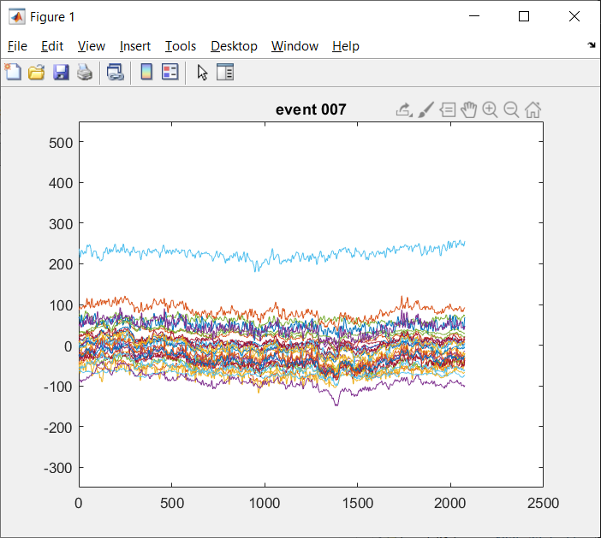
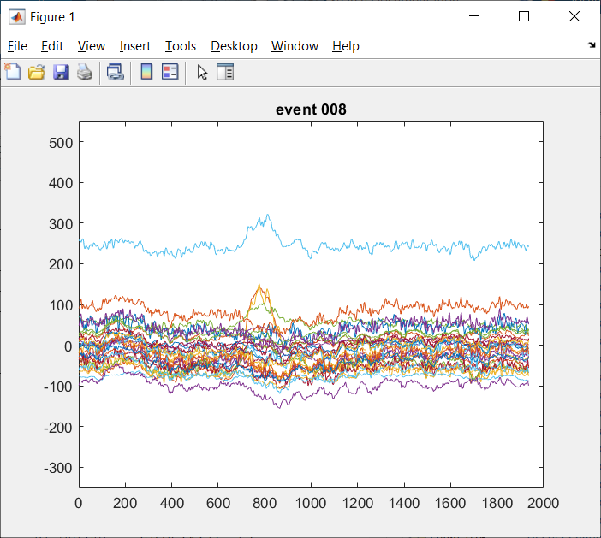
Raw Data – 31 channel full
Dataset subject 1 – events 7 and 8
7 showing little / no response
8 showing central spike in activity
The length of the events differ 1800ms – 2200ms

Slide 4
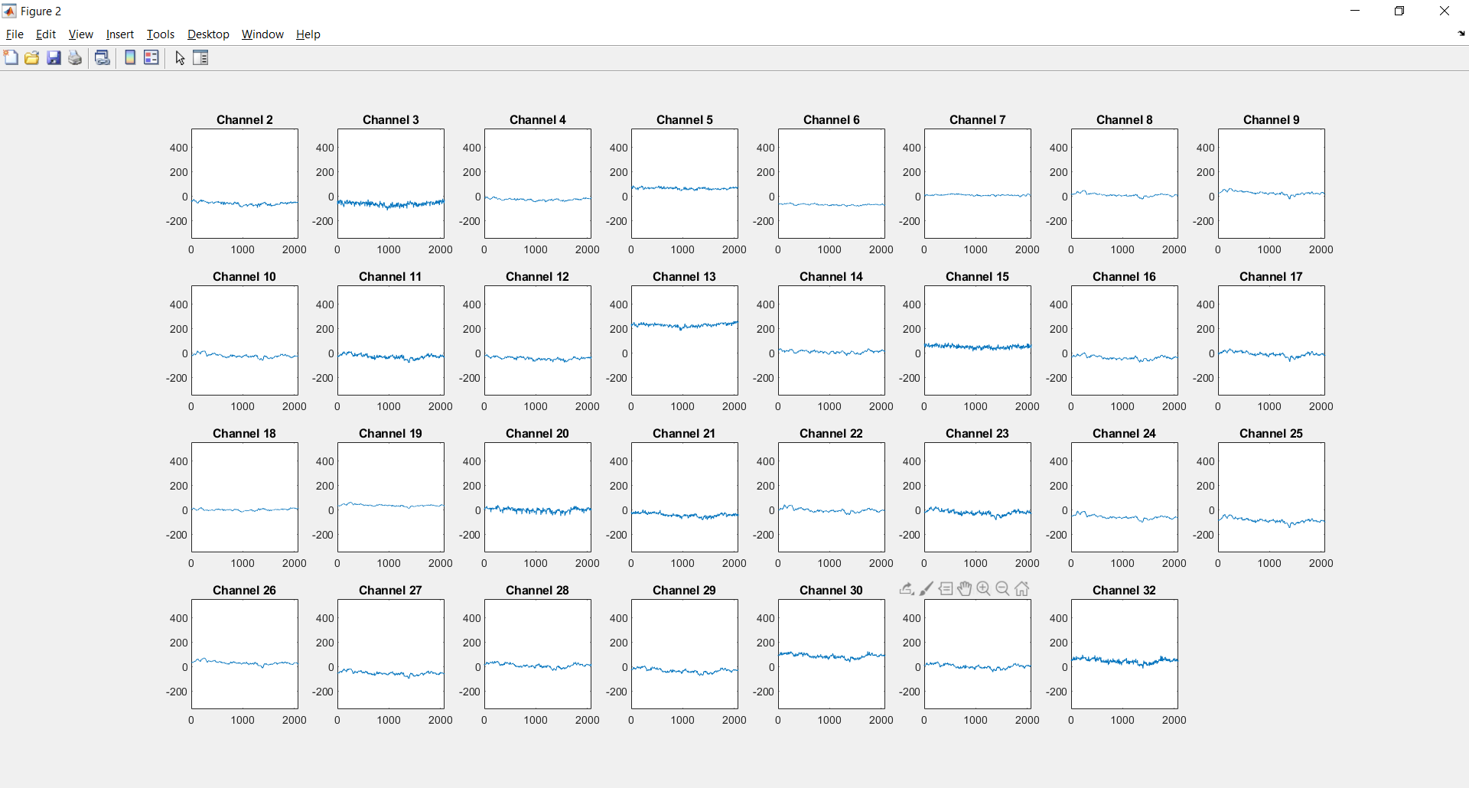
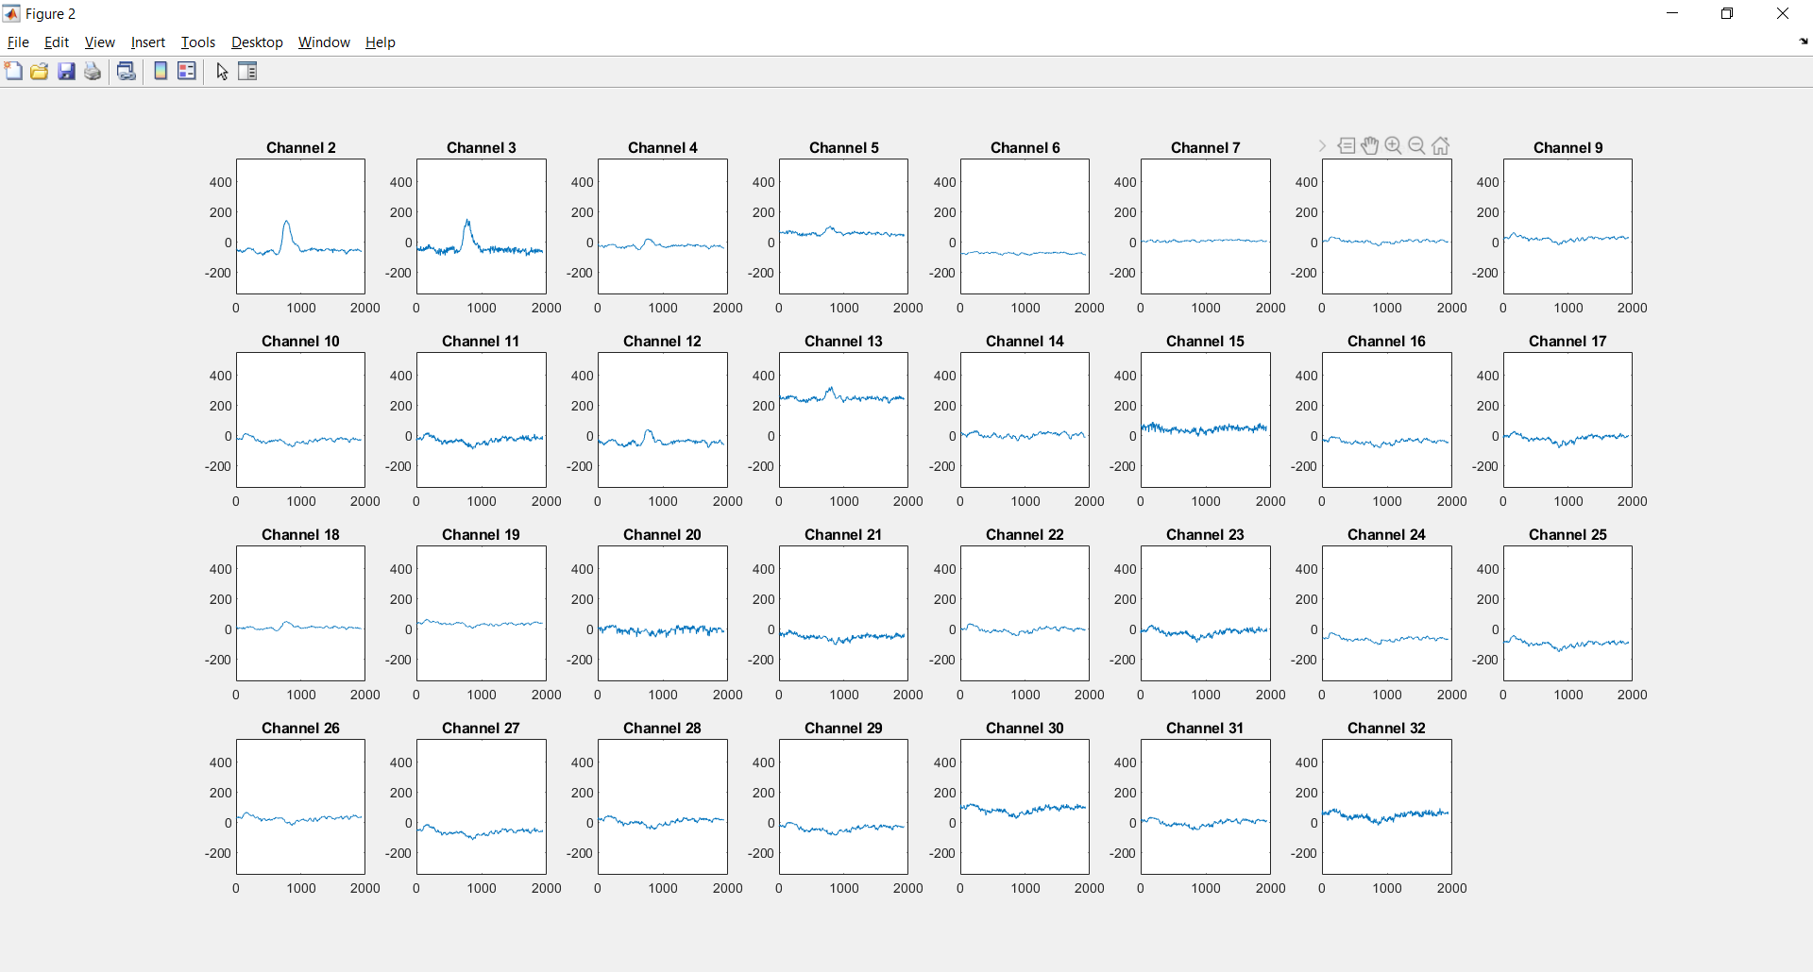
Raw Data – 31 channel split
Event 7
Event 8

Slide 5
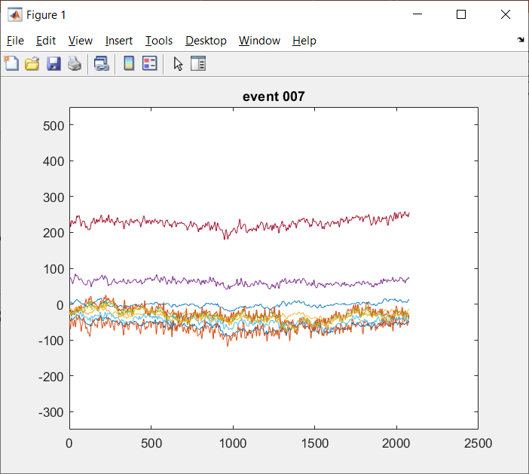
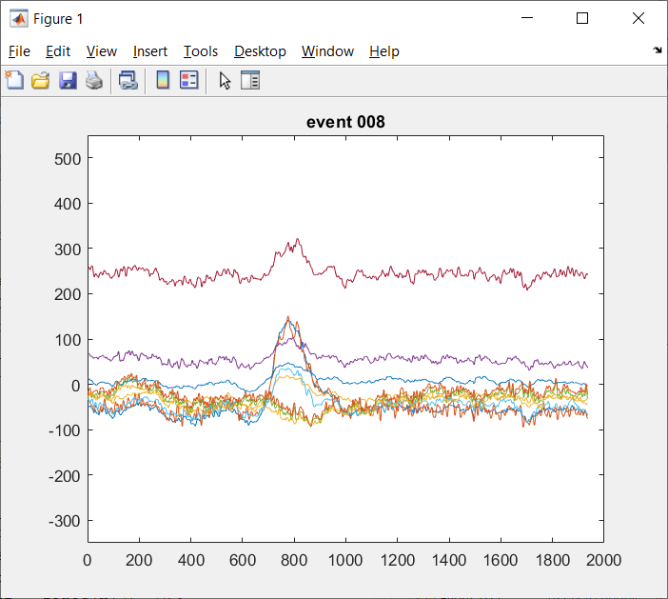
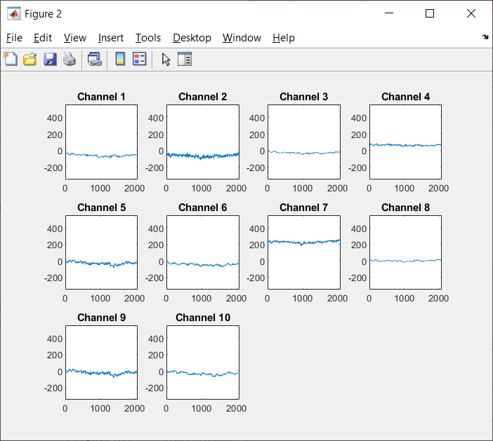
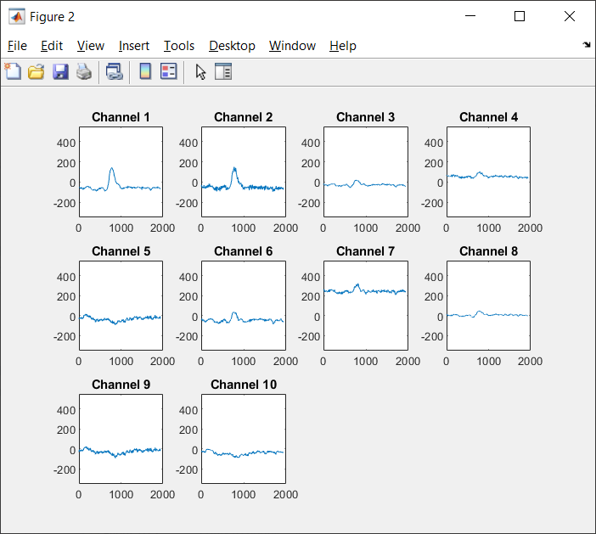
Raw Data – 10 channel
Split by hand into the 9 most distinguishable channels.
Of the original 31 the ones I have kept for the time being are [2,3,4,5,11,12,13,18,23,29]

Slide 6
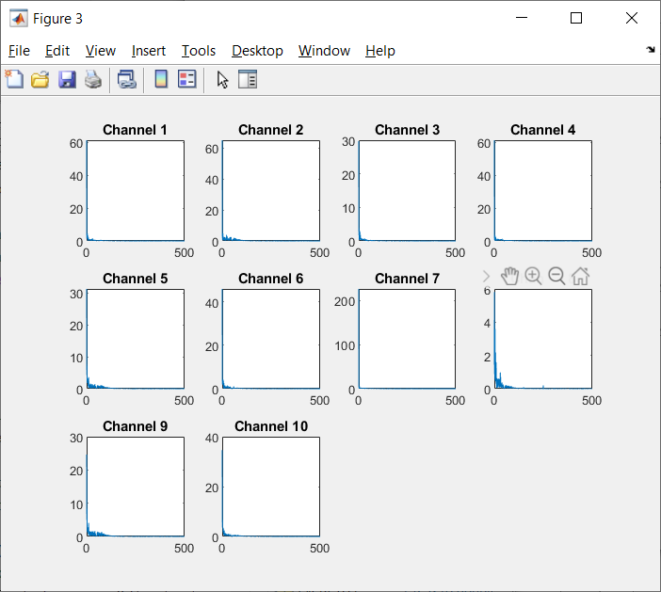
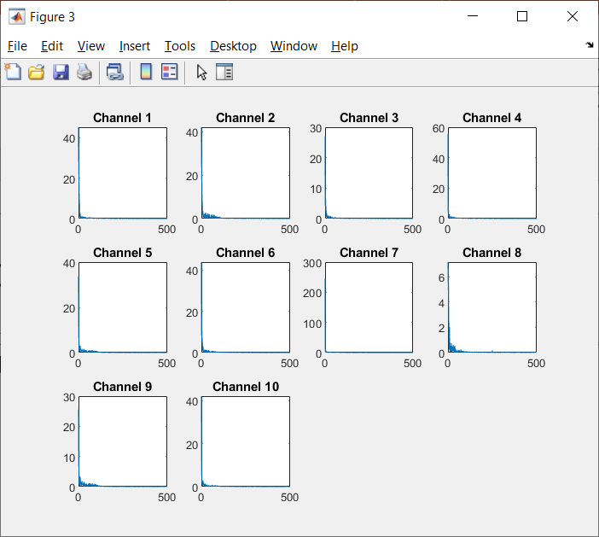
FFT
Output here leans towards the lower frequencies in all cases I have seen. Since the signal centralises around 0.
Not sure what I can do to improve the output here if at all.
Event 7
Event 8

Slide 7
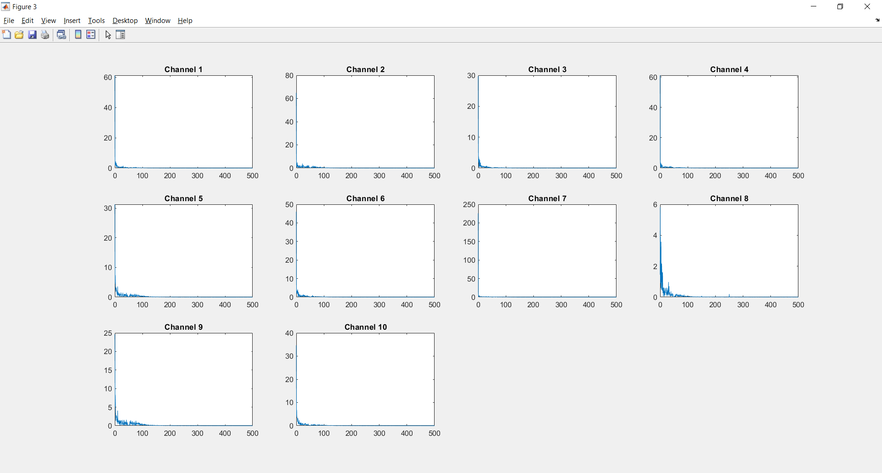
Event 7 – FFT

Slide 8
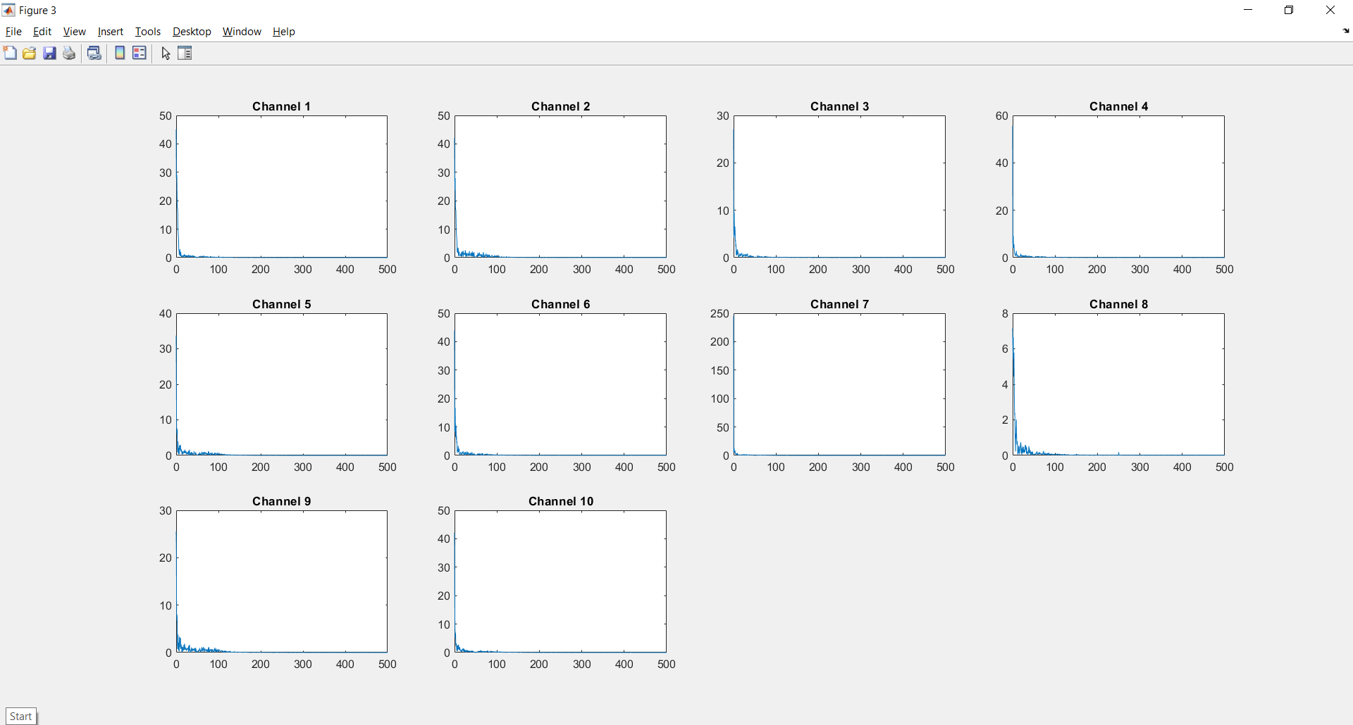
Event 8 – FFT

Slide 9
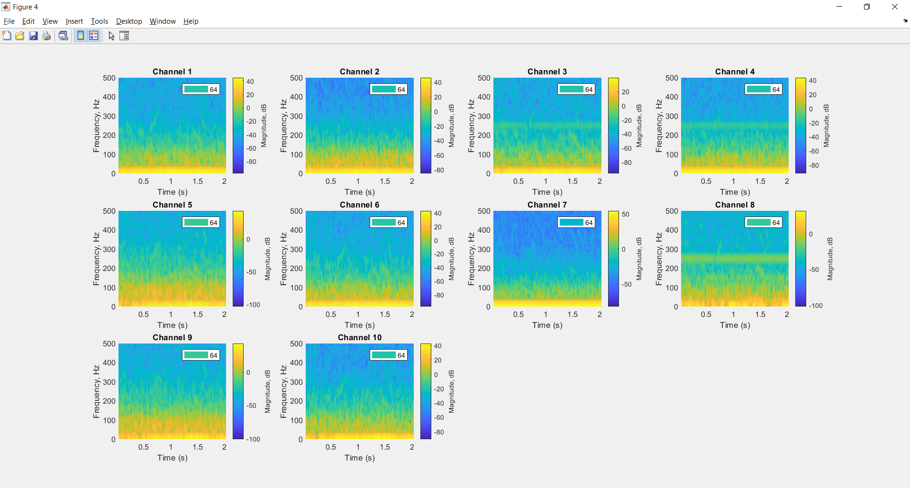
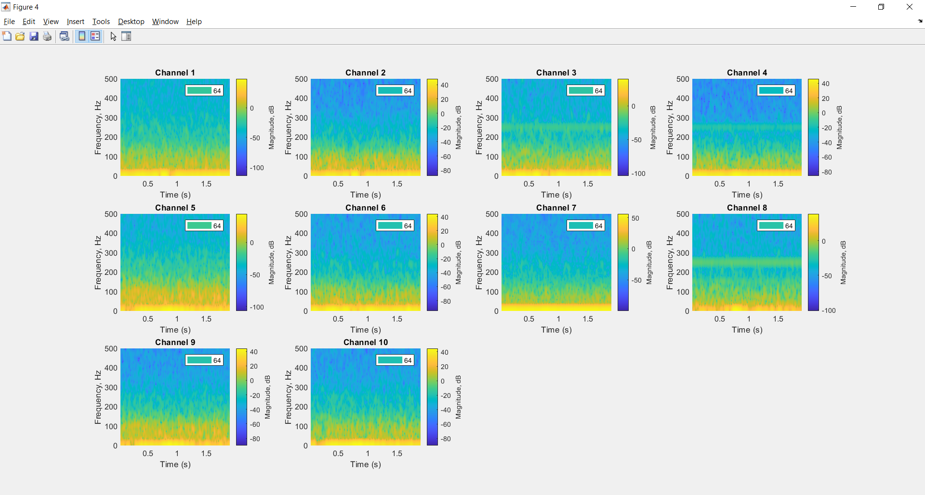
STFT – 64
Event 7
Event 8

Slide 10
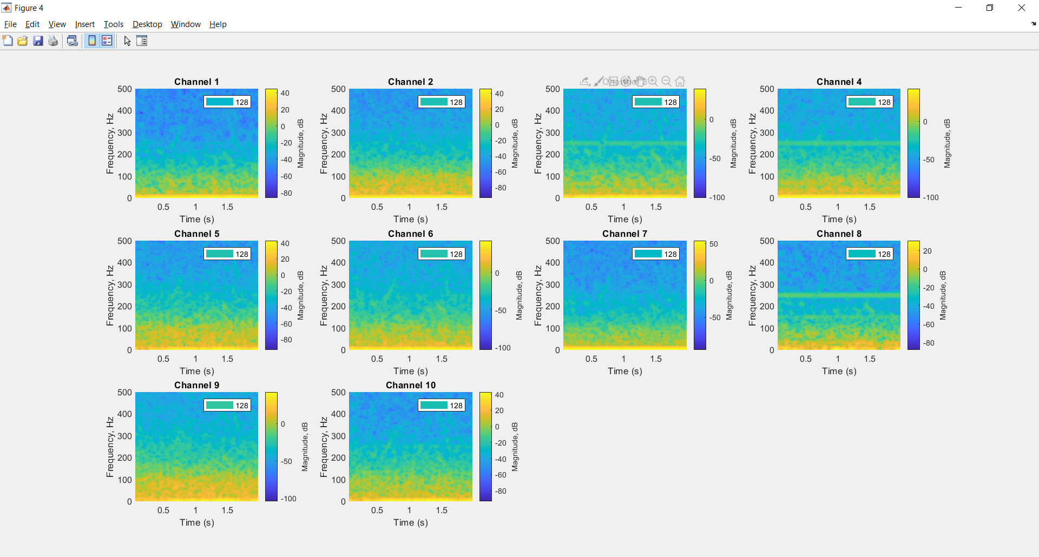
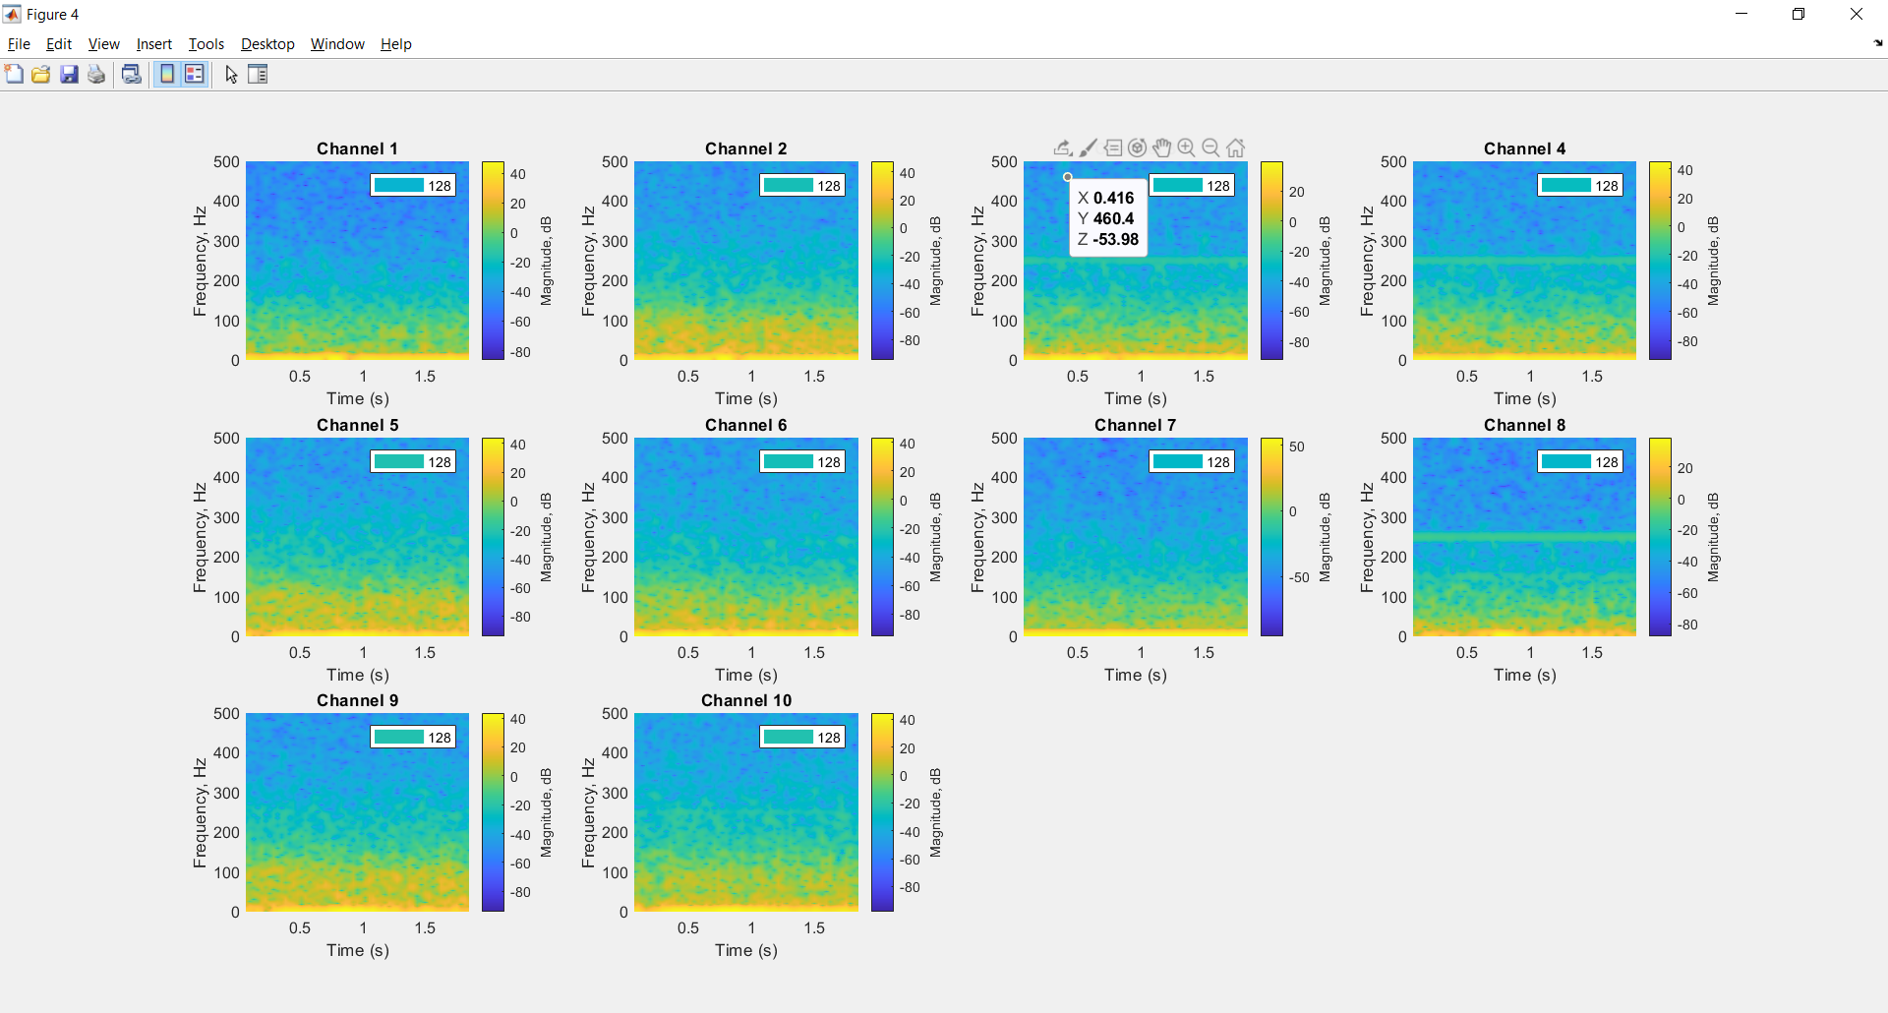
STFT – 128
Event 7
Event 8

Slide 11
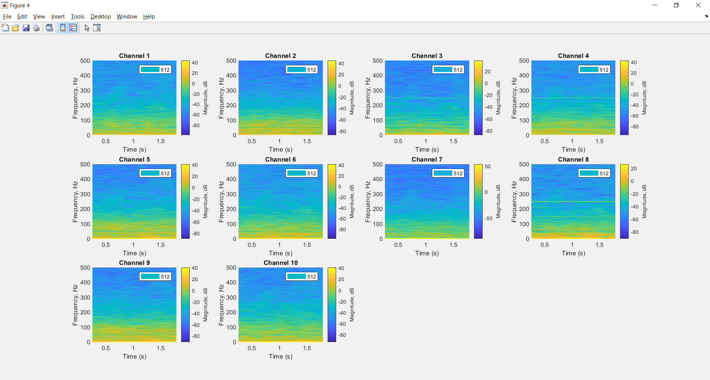
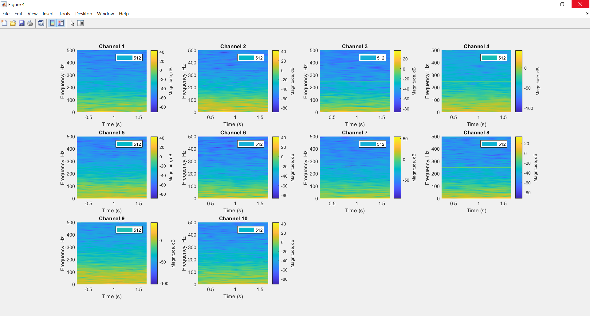
STFT – 512
Event 7
Event 8

Slide 12
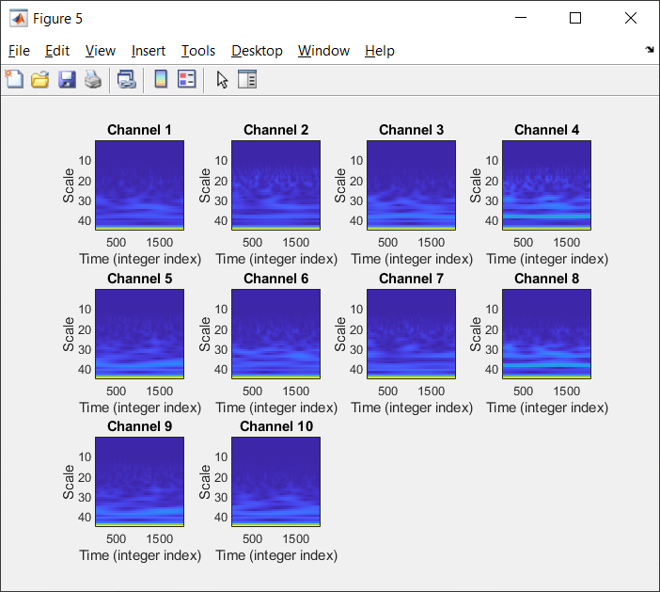
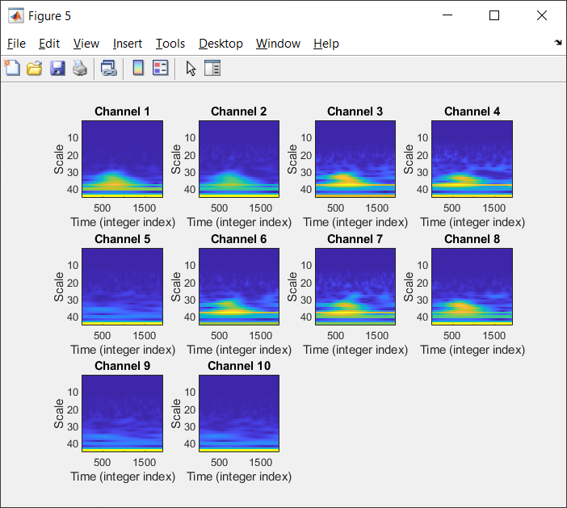
CWT
Event 7
Event 8

Slide 13
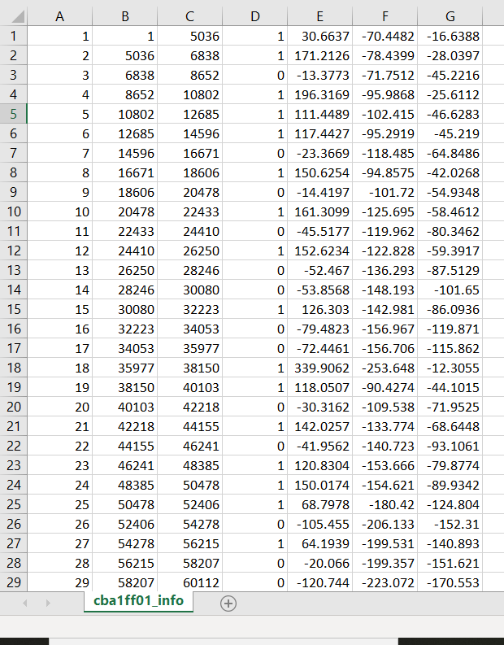
Information
Still working on some of the files, which will have to be normalised / standardised or manually labelled.
A = event number
B = event start
C = event end
D = event spike
E = max amplitude
F = min amplitude
G = mean amplitude

